Slide 1

Transport Layer I: roadmap
Transport Layer Overview
Transport Layer services & functions
Internet Transport Layer
Multiplexing/ De-multiplexing
Connectionless & connection-oriented
User Datagram Protocol – UDP
UDP features
UDP Checksum
Checksum calculation

Slide 2
UDP: User Datagram Protocol
“best effort” service, UDP segments may be:
lost
delivered out-of-order to app
Why is there a UDP?
没有连接建立
没有连接状态
头部小
没有拥塞控制
no connection establishment (which can add RTT delay)
simple: no connection state at sender, receiver
small header size
no congestion control
UDP can blast away as fast as desired!
can function in the face of congestion
connectionless:
no handshaking between UDP sender, receiver
each UDP segment handled independently of others
UDP is “mostly IP with a short transport header”
Source and destination port
Ports allow for dispatching of messages to receiver process

Slide 3
UDP: User Datagram Protocol [RFC 768]
UDP use:
streaming multimedia apps (loss tolerant, rate sensitive)
DNS
SNMP
if reliable transfer needed over UDP (e.g., HTTP/3):
add needed reliability at application layer
add congestion control at application layer
承载网络管理数据
可在应用层添加可靠数据传输、拥塞控制
Notes:
HTTP/3 uses QUIC, a protocol developed initially by Google where user space congestion control is used over UDP.

Slide 4
UDP segment header
32 bits
source port #
dest port #
length
checksum
application
data
(payload)
length, in bytes of UDP segment, including UDP header and UDP data
data to/from application layer
UDP segment format

Slide 5
Transport Layer I: roadmap
Transport Layer Overview
Transport Layer services & functions
Internet Transport Layer
Multiplexing/ De-multiplexing
Connectionless & connection-oriented
UDP Datagram Protocol
UDP features
UDP Checksum
Checksum calculation

Slide 6
UDP checksum
Goal: detect errors (i.e., flipped bits) in transmitted segment
sender:
treat contents of UDP segment (including header fields) as sequence of 16-bit integers
checksum: addition (one’s complement sum) of segment content
checksum value put into UDP checksum field
receiver:
compute checksum of received segment
check if computed checksum equals checksum field value:
Not equal - error detected
Equal - no error detected. But maybe errors nonetheless? More later ….

Slide 7
UDP Checksum (cont.)
How to compute checksum:
Add all 16-bit words
add any carry bits back in
flip bits in sum to get checksum
Note: we’ll see same algorithm in detail when we look at IP
UDP checksum covers pseudo header of information from the IP header, the UDP header and the UDP data/payload
UDP checksum computation is optional for IPv4 (set to the value zero); mandatory when UDP runs over IPv6 (computation method changed).
相加所有16bit word(注意，UDP宽度32bit)
加进位
取反码
checksum组成
IP 头部
UDP 头部
UDP 数据
32 bits
4 bytes
Source Port
Destination Port
Length
Checksum

Slide 8
UDP IPv4 Pseudo Header
UDP checksum based on pseudo header not real one
Protocol must = 17 (UDP)
Source and dest. addresses must match real IP header
UDP length must match value in UDP header
32 bits
4 bytes
Source IP Address
Destination IP Address
= 0
Proto. = 17
UDP Length
Notes:
The pseudo header is used only for this calculation and is then discarded; it is not actually transmitted.

Slide 9
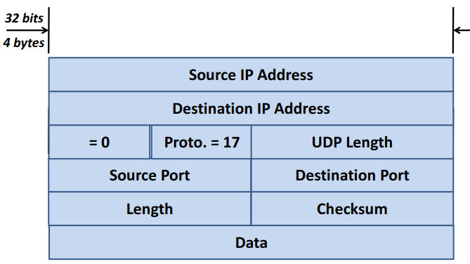
Fields Used for Computing UDP Checksum
Pseudo Header
UDP Header
UDP data

Slide 10
Internet checksum: an example
example: add two 16-bit integers
1 1 1 0 0 1 1 0 0 1 1 0 0 1 1 0
1 1 0 1 0 1 0 1 0 1 0 1 0 1 0 1
wraparound
1 1 0 1 1 1 0 1 1 1 0 1 1 1 0 1 1
sum
1 0 1 1 1 0 1 1 1 0 1 1 1 1 0 0
checksum
0 1 0 0 0 1 0 0 0 1 0 0 0 0 1 1
1s complement to get the checksum
Note: the overflow bit needs to be wrapped around.
Notes:
1s complement to get the checksum: converting all the 0s to 1s and converting all the 1s to 0s

Slide 11
Internet checksum: weak protection!
example: add two 16-bit integers
0 1
1 1 1 0 0 1 1 0 0 1 1 0 0 1 1 0
1 0
1 1 0 1 0 1 0 1 0 1 0 1 0 1 0 1
wraparound
1 1 0 1 1 1 0 1 1 1 0 1 1 1 0 1 1
Even though numbers have changed (bit flips), no change in checksum!
sum
1 0 1 1 1 0 1 1 1 0 1 1 1 1 0 0
checksum
0 1 0 0 0 1 0 0 0 1 0 0 0 0 1 1

Slide 12
Summary: UDP
“no frills” protocol:
segments may be lost, delivered out of order
best effort service: “send and hope for the best”
UDP has its plusses:
no setup/handshaking needed (no RTT incurred)
can function when network service is compromised
helps with reliability (checksum)
build additional functionality on top of UDP in application layer (e.g., HTTP/3)

